Slide 1
Predicting optimal time duration to find Best Dating Match
Presentation by:
Smriiti Singhal

Slide 2

Goal
Online Dating Website
Recommends- a list of potential best matches
First meeting in real life
Predict the best time to make choice- to have highest probability to find the best matched person

Slide 3
Why ?
Convential way :
Time Consuming
Inefficient
Low success rate

Slide 4

User Interface
Input fields
Input user information
Database
~ 200 people dataset

Slide 5
User Information
Personality- Introvert, extrovert, ambivert
Partner’s Personality type
Interests - travelling
adventures
partying
sports
pets
music
programming…
First Name
Last Name
Gender- Male, Female, other
Gender you are looking for
Age-
Country
City
Nationality

Slide 6

Tell us your 3 highest priority parameters. The number of matches Meeting order- random or highest to lowest base score
Look in the database

Slide 7
Give an individual Base_Score to each person
If a preference match – add to the score.
If a preference match which is among one of the highest priority fields – add more weightage to the score.
Give top 15 potential best matches – based on Base_Score

Slide 8
Special Scenario
Suppose 15 th and 16 th person have same base score- TIE
Tie Breaking
Algorithm
More weightage to priority paramets

Slide 9
variable of uncertainty
Impression Score- obeys Normal Distribution
impression_score = scipy.stats.norm.rvs(loc=20, scale=5)
final_score = base_score + impression_score

Slide 10
Code Snippet
# get the best final score among all the candidates for index in range(candidate_num): impression_score = scipy.stats.norm.rvs(loc=score_avg, scale=1) # the impression score obeys normal distribution final_score = candidate_base_score[index] + impression_score candidate_final_scores[index] = final_score if final_score > best_score: best_index = index best_score = final_score

Slide 11
Failure Probability
Prob. of user failing to get the best candidate
Three Scenarios

Slide 12
Probability of refusal before meeting – constant value.

Slide 13
2. Probability of person chosen by someone else- obeys linear pattern
If candidate has good matches with other people
probability further increases
Prob (chosen)
Time lapsed

Slide 14
person_score = [] for i in range(len(candidates_list)): score_sum = 0 score_count = 0 for j in range(len(candidates_list)): if i == j or candidates_list[i]['gender'].lower() == candidates_list[j]['gender'].lower(): continue score_count += 1 score_sum += self.get_base_score(candidates_list[i], candidates_list[j]) person_score.append(score_sum / score_count) total_avg_score = sum(person_score) / len(person_score) for i in range(len(person_score)): if person_score[i] >= total_avg_score: candidates_list[i]['is_competitive'] = 1 else: candidates_list[i]['is_competitive'] = 0 return candidates_list

Slide 15

3. Probability of rejecting bcuz tired of waiting/loose interest-
obeys exponential pattern
0.3 * math.exp(stop_time) / math.exp(candidate_num)
Prob (tired of waiting)
Time lapsed

Slide 16
failure_prob = Prob(refuse before meet)
+
Prob(chosen by someone else)
+
Prob(looses interest / tired of waiting)

Slide 17
failure_prob = 0.05
+
(0.5 + 0.1*top_candidates_list[current_best_index]['is_competitive'])*stop_time/ candidate_num
+
0.3 * math.exp(stop_time) / math.exp(candidate_num)

Slide 18
Monte Carlo Simulation Model the probability of different outcomes in a process that cannot be easily predicted due to the presence of random variables. Simulating the code 10,000 times

Slide 19
USER 1

Slide 20
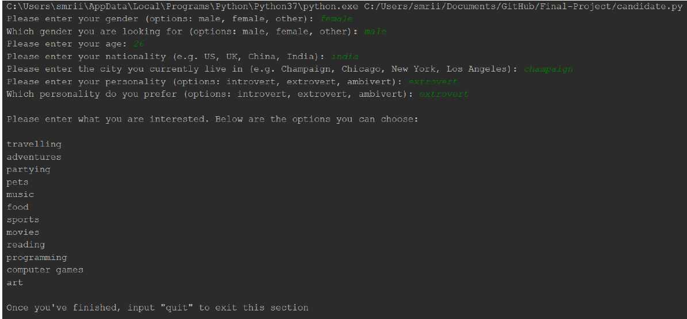

Slide 21
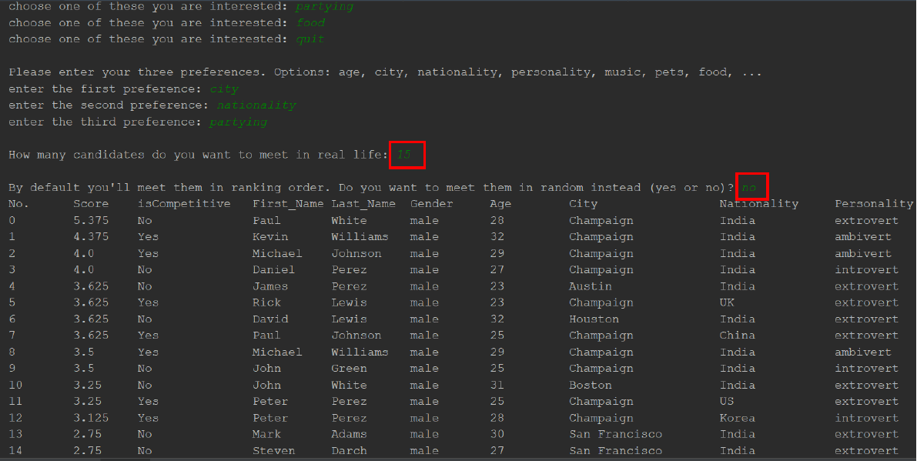

Slide 22
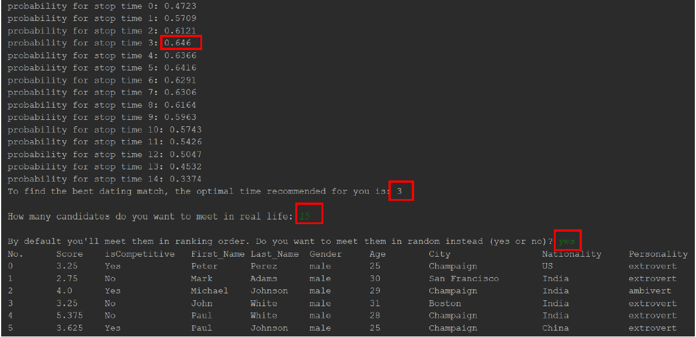

Slide 23
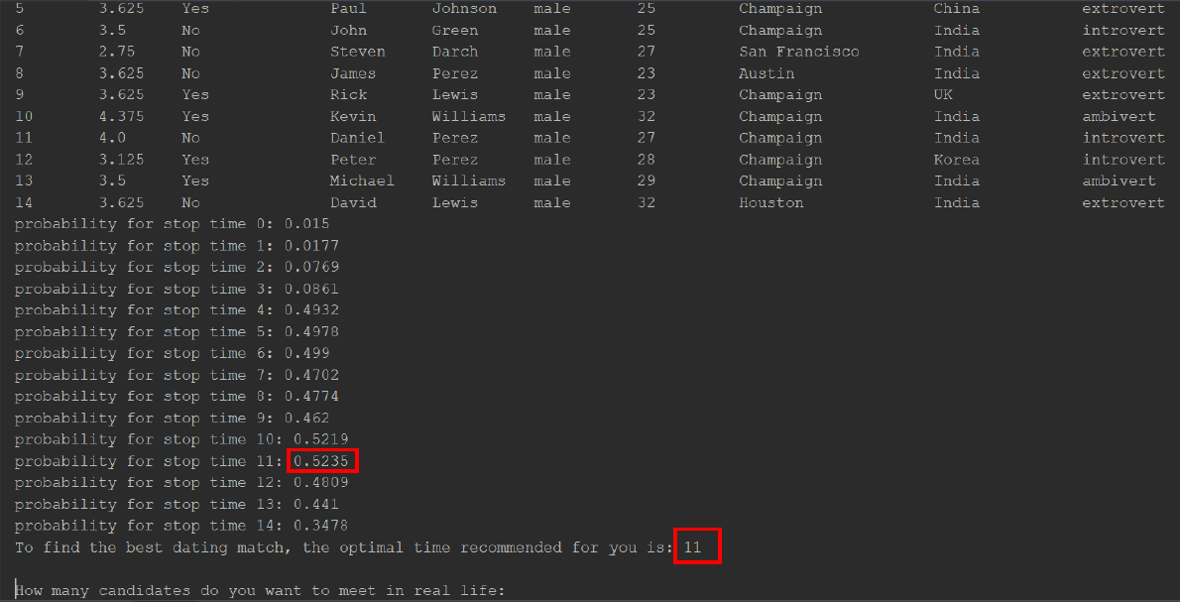

Slide 24
USER 2

Slide 25
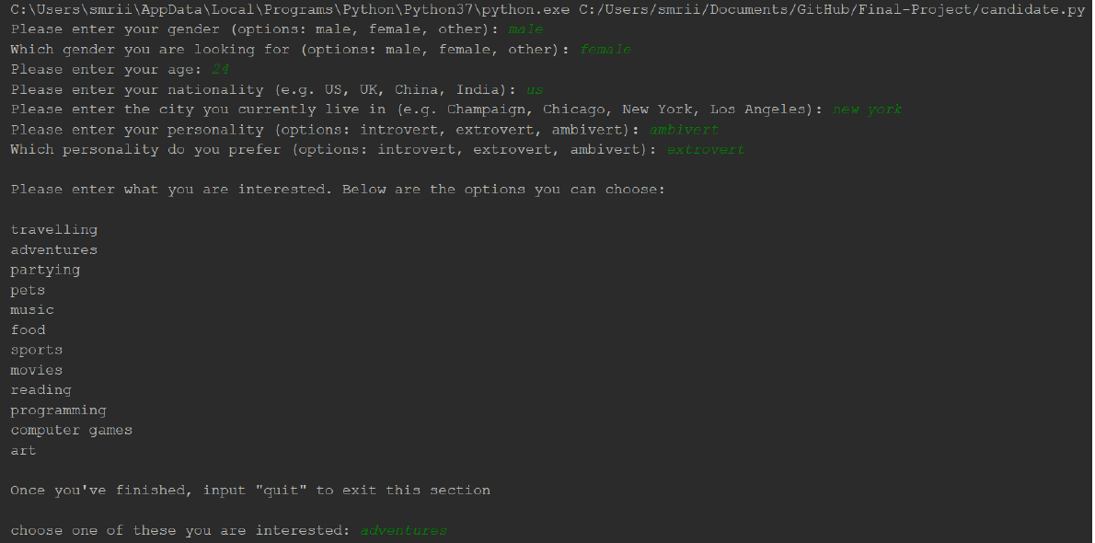

Slide 26
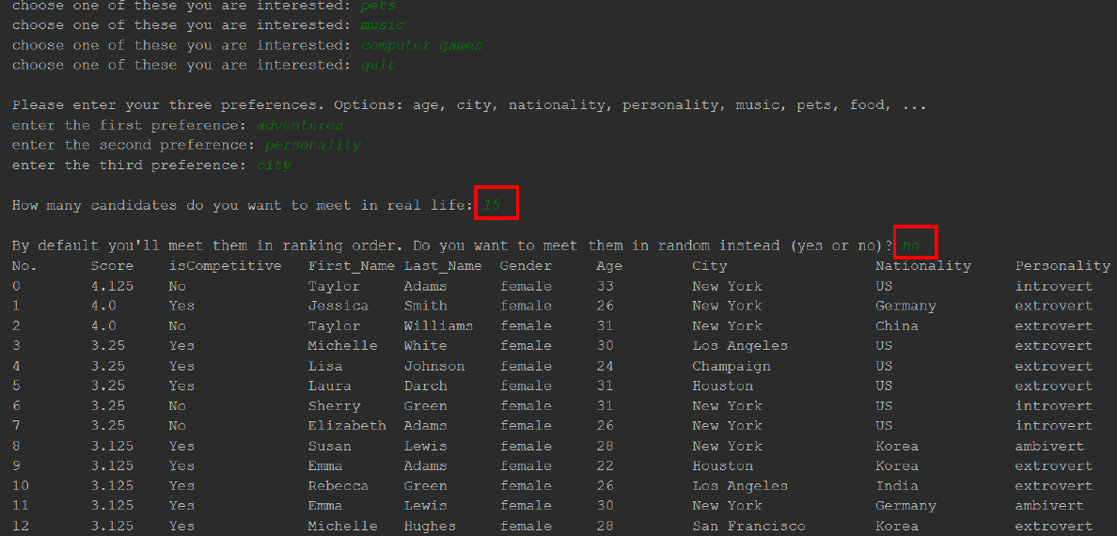

Slide 27
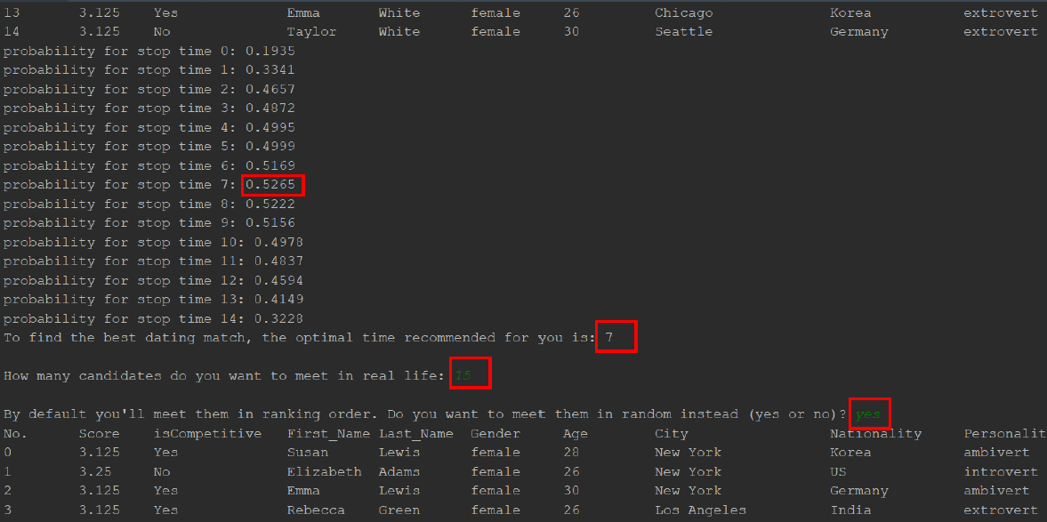

Slide 28
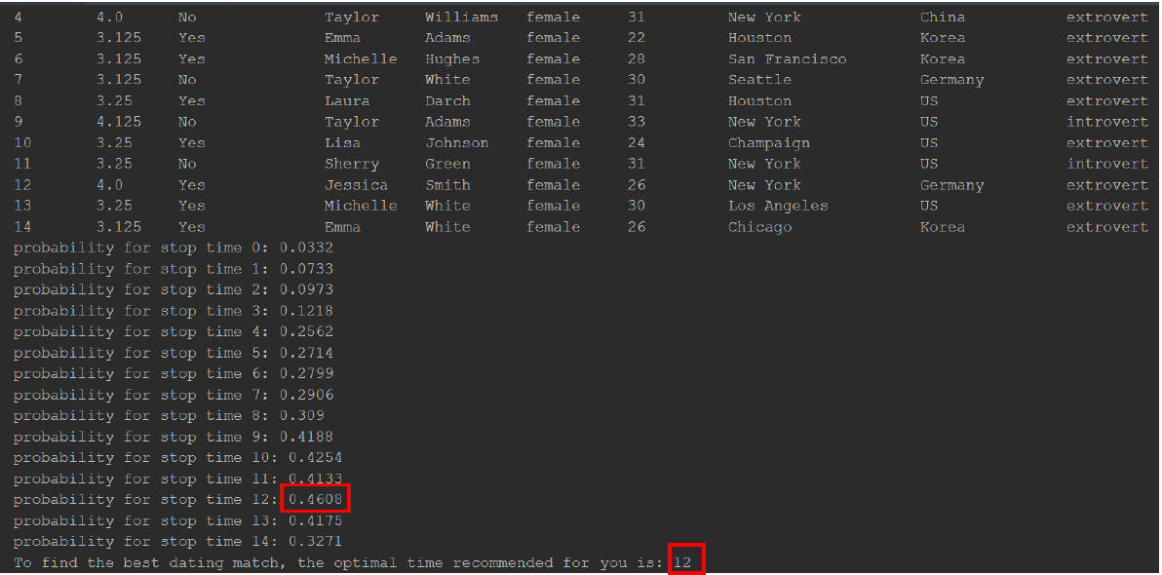

Slide 29
My Contribution Project idea User Input Base score Matched person is competitive or not Prob of loosing interest Testing

Slide 30
Thank you…

